Slide 1


WEB SCRAPPING
Submitted By:
Rishika Gupta (TEAM ELITE)

Slide 2
INDEX
Technologies used
Usage of libraries
Code for WebScrapping Multiple pages
Code
Screenshot of the csv file
Github Link

Slide 3


TECHNOLOGY USED
PYTHON Programming Language
Libraries used: Requests, Cloudscraper, BeautifulSoup, Pandas

Slide 4
USAGE OF LIBRARIES
Requests: Requests library is one of the integral parts of Python for making HTTP requests to a specified URL For Installation: pip install requests
Cloudscraper: It is a web scraping library built exclusively for retrieving data from Cloudflare-protected websites. This ability and its compatibility with popular libraries like Python Requests and BeautifulSoup make it a valuable tool for data extraction. It is used to overcome the 403 forbidden error.For Installation: pip install cloudscraper
BeautifulSoup: Beautiful Soup is a Python package for parsing HTML and XML documents (including having malformed markup, i.e. non-closed tags, so named after tag soup). It creates a parse tree for parsed pages that can be used to extract data from HTML, which is useful for web scraping. For Installation: pip install beautifulsoup4
Pandas: Pandas is an open-source library in Python that is made mainly for working with relational or labeled data both easily and intuitively. It provides various data structures and operations for manipulating numerical data and time series.Here it is used for creating dataframes and coverting the dataframes into csv For Installation: pip install cloudscraper

Slide 5
In this challenge, The task was to develop a program capable of extracting specific information from multiple web pages and saving data gathered in either Excel or CSV. For getting data from multiple pages a for loop will be used and we will use the next page button url to load the next page as such np=soup.find("a",class_="next page-numbers").get("href")
WEB SCRAPPING MULTIPLE PAGES

Slide 6

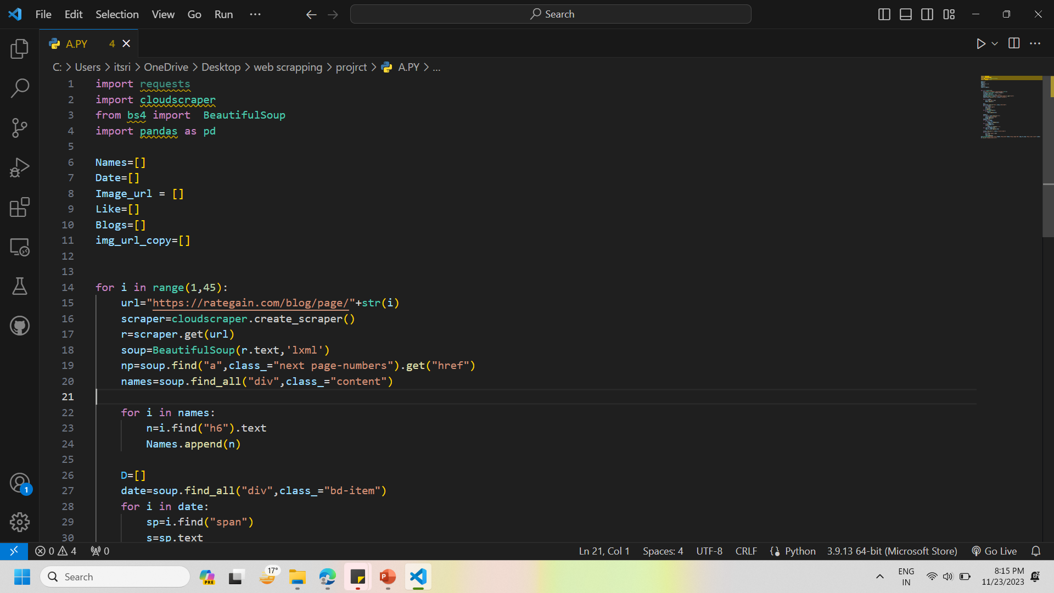
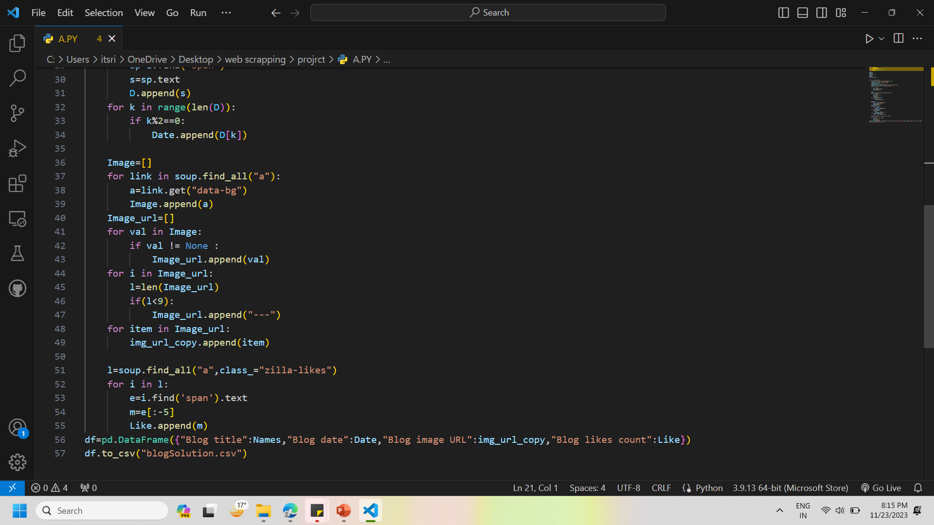
Code

Slide 7
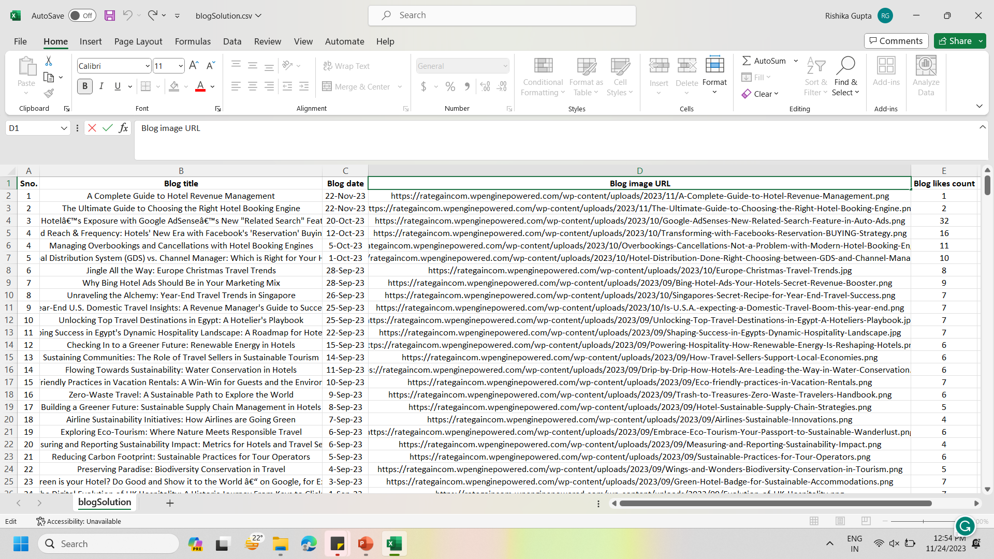
SCREENSHOT OF THE CSV FILE

Slide 8
GITHUB LINK
https://github.com/Rishika21Gupta/Web-Scrapping-Project.git

Slide 9
THANK YOU

